Slide 1
Bad Rabbit
Bad Rabbit
Not Your Typical Ransomware
David Small, Daniel Ma, Eric Rios, Chadwick Spencer, Bruce Blankenship, Daniel Rios
gif: www.giphy.com

Slide 2
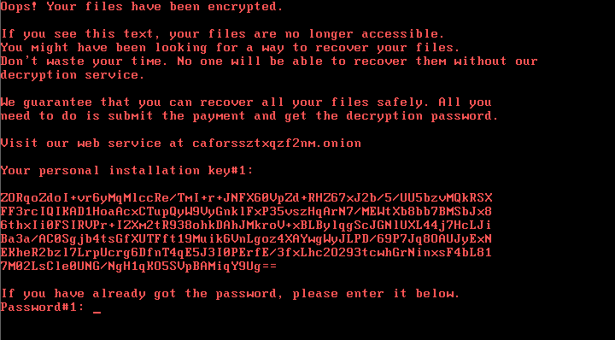
What Is It?
Bad Rabbit is a ransomware attack
Attacks were focused on Russian media outlets ⁽¹⁾
Drive-by attack propagated by downloading and running a fake Adobe Flash installer from infected websites⁽¹⁾
It encrypts a user’s files and replaces the master boot record⁽¹⁾
Uses EternalRomance exploit to move on the local network⁽¹⁾
(1) https://securelist.com/bad-rabbit-ransomware/82851/
Image:https://securelist.com/bad-rabbit-ransomware/82851/

Slide 3


Victims of BadRabbit
Mainly targets corporate, non-civilian networks
Infected many Russian media outlets¹
Major victims²:
Fontaka (Russian news site)
Interfax (Russian news & info service)
Kiev Metro (Ukraine)
Smaller victims around the world
Threatened to block or release sensitive data
¹ https://www.kaspersky.com/blog/bad-rabbit-ransomware/19887/
² https://span.eu/en/2017/10/5-facts-about-the-new-bad-rabbit-ransomware-attack/
Notes:
BadRabbit reboots the system
https://securelist.com/bad-rabbit-ransomware/82851/

Slide 4
What damage has it done?
Prevents computers from booting normally
Ransom: .05 BTC (~$280 USD)
Likely not a wiper
Attackers can technically decrypt data
Distribution stopped evening of detection¹
2017 October 24
¹ https://securelist.com/bad-rabbit-ransomware/82851/
Image: https://media.kasperskydaily.com/wp-content/uploads/sites/92/2017/10/24124149/badrabbit_1.gif

Slide 5
Steps to Prevent and Mitigate Damage
Only update or install files from official websites. This is how the ransomware disguises itself
Set policy and procedure to patch systems regularly and/or on an automated basis
Constantly backup all of your systems¹
Block the execution of the c: \ windows \ infpub.dat and c: \ Windows \ cscc.dat files
Disable the WMI service to prevent Bad Rabbit from spreading across a network.²
¹https://zvelo.com/bad-rabbit-season/#:~:text=A%20robust%20patching%20system%20should,combating%20ransomware%20can%20be%20easy.
²https://www.hitachi-systems-security.com/blog/bad-rabbit-ransomware-what-to-know-and-how-to-prevent-it/

Slide 6
Vulnerability: Social Engineering¹
Exploit: No initial exploit is used; user manually downloads malicious Adobe Flash Player. The EternalRomance exploit is the infection vector for propagating through networks.¹
Threat Actors: Unknown but believed to be the same threat actors behind NotPetya ²
1.https://securelist.com/bad-rabbit-ransomware/82851/#:~:text=No%20exploits%20were%20used%2C%20so,was%20used%20in%20the%20ExPetr
2. https://usa.kaspersky.com/blog/bad-rabbit-ransomware/13106/

